Slide 1
Research Question
Over the course of four weeks, I tracked my productivity while completing Russian homework assignments in order to better understand what factors influence my performance. Each study session lasted two hours, and I maintained consistent conditions by minimizing distractions, avoiding phone use, aiming for the same amount of sleep each night, and studying at the same time, in the morning before going to class/work. The primary variable I investigated was study location, specifically comparing studying at home versus studying at school. My goal was to determine whether the environment in which I study has a measurable impact on my productivity. Productivity was measured as the percentage of assigned homework completed during each session, which I calculated by counting the number of sections I completed out of the total assigned and then converting that into a percentage, rounding up to the nearest whole number. Based on this setup, my research question is: Does study location, specifically home versus school, affect my productivity? I hypothesized that I would be more productive when studying at school compared to studying at home, because the school environment is more structured and better suited for focused academic work. I hypothesized that I would be more productive when studying at school compared to studying at home, because the school environment is more structured and better suited for focused academic work.

Slide 2
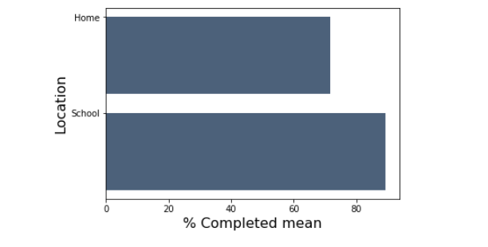
Location vs Productivity
In this analysis, I grouped my data by study location and calculated the average percentage of homework completed in each location. I then used a bar chart to compare my average productivity when studying at home versus at school. The chart shows that my average productivity was higher when studying at school than when studying at home. This supports my hypothesis that study environment affects my ability to complete work efficiently. Even though I kept study duration and other conditions relatively consistent, location still appears to have had a noticeable impact on my performance.

Slide 3
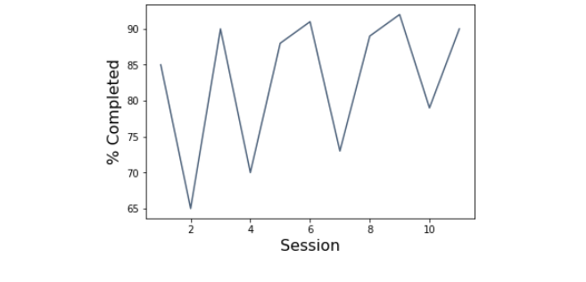
Trend Over Time
To make a line graph, I created a new session column to track numerical data for each week. From the graph we can see a slow upward trend in my productivity (% of work complete). However, the line tracks both days where I studied at home and at school, resulting in the dip in productivity each 2nd session.

Slide 4
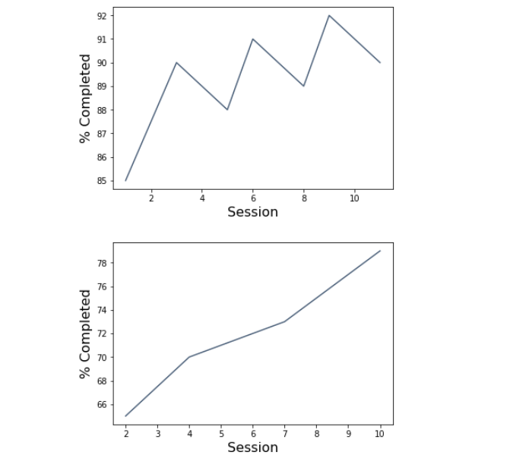
Separated Trends
In this analysis, I separated my data into two groups based on study location (school and home) and created line charts to observe productivity trends within each environment. Each chart shows the percentage of homework completed across study sessions. The top graph represents school sessions, where productivity remains consistently high, generally staying between 85% and 92%. Although there are small fluctuations, the overall performance is stable and consistently strong. The bottom graph represents home sessions, where productivity is noticeably lower but shows a gradual upward trend over time. This suggests that while I may be improving slightly when studying at home, my performance still does not reach the same level as when studying at school.

Slide 5
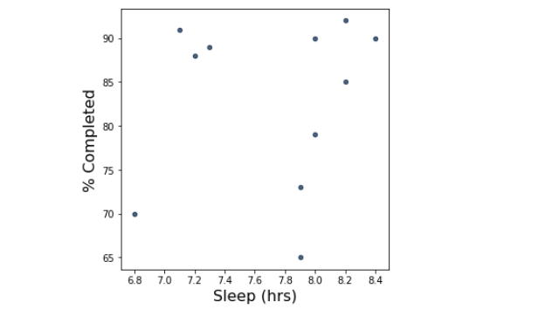
Sleep vs Productivity
In this analysis, I created a scatter plot to examine the relationship between sleep duration and my productivity during study sessions. Sleep duration (in hours) is plotted on the x-axis, while productivity, measured as the percentage of homework completed, is plotted on the y-axis. Each point represents a single study session. The plot shows a very weak correlation between sleep and % work complete.

Slide 6
Conclusion/Individual Reflection
Overall, my results show that study location had a clear and consistent impact on my productivity. Across all four weeks, I consistently completed a higher percentage of my Russian homework when studying at school compared to studying at home. This pattern remained stable over time, even though I controlled for other factors such as study duration, sleep, time of day, and distractions. While I did see slight improvement when studying at home, my performance in that environment never reached the same level as my school sessions. This suggests that the structure and academic setting of studying at school play a significant role in helping me stay focused and efficient. The main challenges I had began from the start of the project, where I struggled to figure out how to make a proper experiment to answer my question. I struggled because most of my classes didn't give me a lot of homework consistently, and It would be difficult to figure out when to best track the experiments every week. During the experiment, I first had problems with how best to display my data properly. When asked to analyze my data at the end, I wasn’t sure how to properly use the table functions to visualize some of the data. These challenges helped me better understand the process of designing an experiment, collecting consistent data, and learning how to interpret and present that data effectively. They also showed me that experimentation is not always straightforward, and that refining both the experiment and the analysis is an important part of the learning process. Moving forward, I would continue collecting data over a longer period of time and improve how I organize and visualize my data to make my conclusions even stronger.

